Slide 1
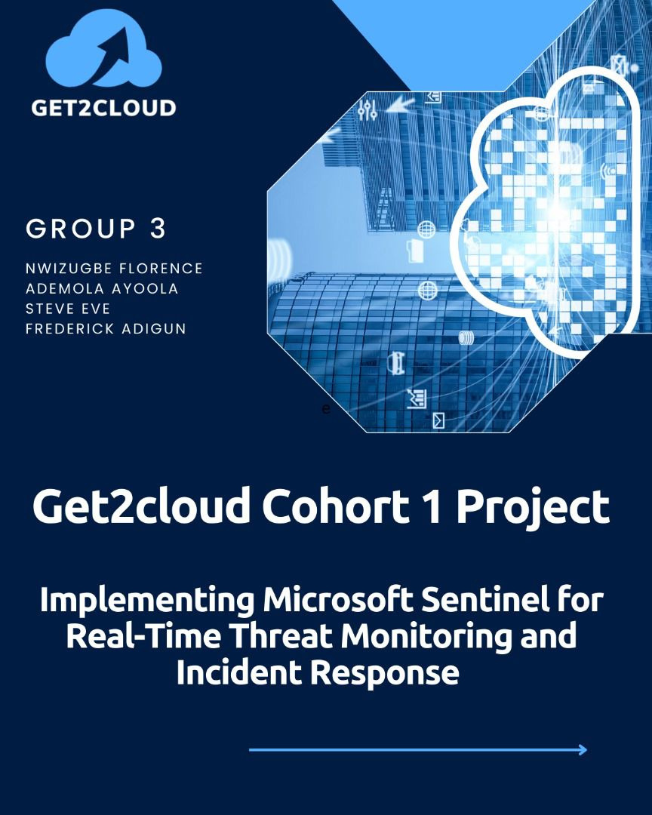

Slide 2

Outline
1. Introduction
2. Key Features and Benefits
3. Architecture and Components
4. Setting Up Microsoft Sentinel
5. Real-Time Threat Monitoring
6. Incident Response with Microsoft Sentinel
7. Best Practices
8. Challenges
9. Mitigation Strategies
10. Conclusion

Slide 3
Introduction
What is Microsoft Sentinel?
Microsoft Sentinel is a cloud-native security information and event management (SIEM) and security orchestration, automation, and response (SOAR) solution that helps organizations to collect, detect, investigate, and respond to security incidents and threats.
Microsoft Sentinel provides attack detection, threat visibility, proactive hunting, and threat response to help stop threats before they cause harm.
What is a Threat
A threat is any circumstance or event that can negatively impact assets e.g social engineering attack, brute force attack.
An asset is any item perceived as having value to an organization e.g Copyright data, Customer PII, Physical space

Slide 4
Key features and Benefits
-Data collection
-Detection
-Investigation
-Response

Slide 5
Data collection
1.Out of the box collectors eg Microsoft Entra ID, Azure activity, Azure storage, (Others e.g syslog, CEF, REST-API).
2. Custom connectors - When unable to connect data source to Sentinel using an existing solution, create your own data source connector.
3. Data normalization - Sentinel uses both query time and ingestion time normalization to translate various sources into a uniform, normalized view.

Slide 6
Detection of threats
Analytics
MITRE ATT&CK coverage
Threat Intelligence
Wachlists
Workbooks

Slide 7
Investigate Threats
Incidents
Hunts
Notebooks

Slide 8
RESPONSE
1. Playbooks
- Automated response workflows using Azure Logic Apps.
2. Investigation Tools
- Built-in investigation tools to analyze incidents.
3. Case Management
- Incident tracking and management.
4. Collaboration
- Integration with Microsoft Teams and other tools for collaborative response.

Slide 9
Setting Up Microsoft Sentinel
1. Create a Log Analytics Workspace
- Navigate to the Azure portal and create a new Log Analytics workspace.
2. Enable Microsoft Sentinel
- Add Microsoft Sentinel to the newly created workspace.
3. Connect Data Sources
- Integrate data from various sources (Azure, on-premises, other cloud providers).
4. Configure Analytics and Alerts
- Set up analytics rules and alert policies.

Slide 10
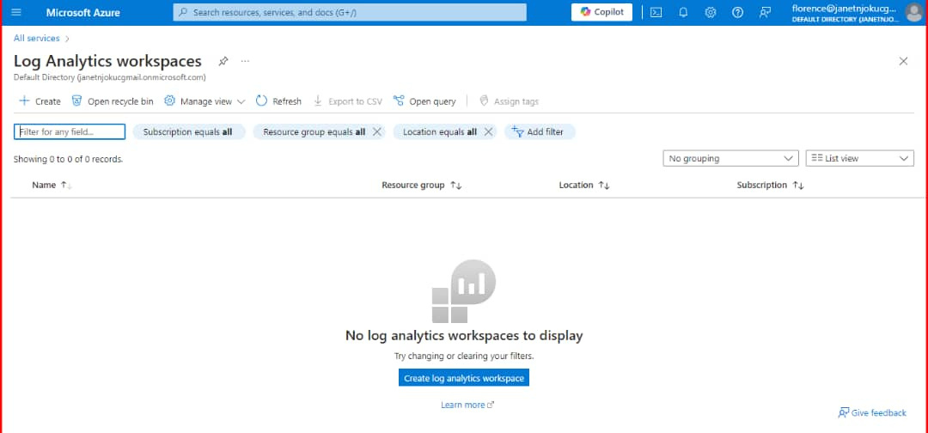
Empty Log Analytics Workspace

Slide 11
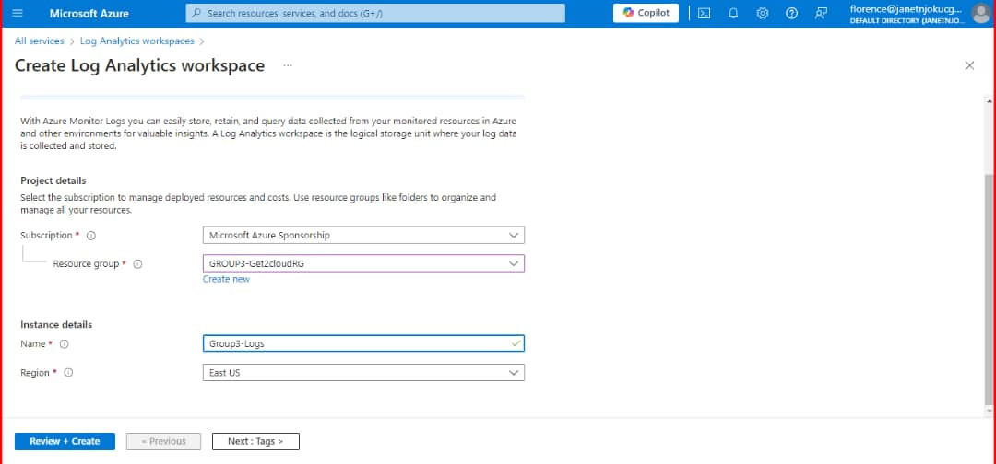
Creating a Log Analytics Workspace

Slide 12
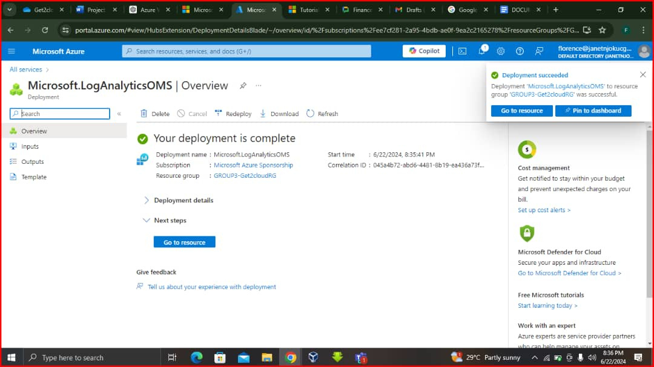
Log Analytics Workspace deployment complete

Slide 13
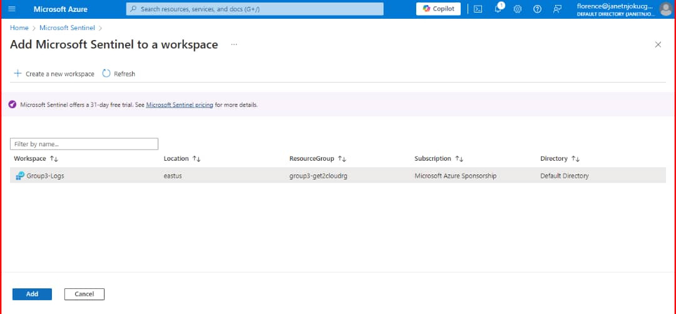
Enabling Microsoft Sentinel on the created Workspace

Slide 14
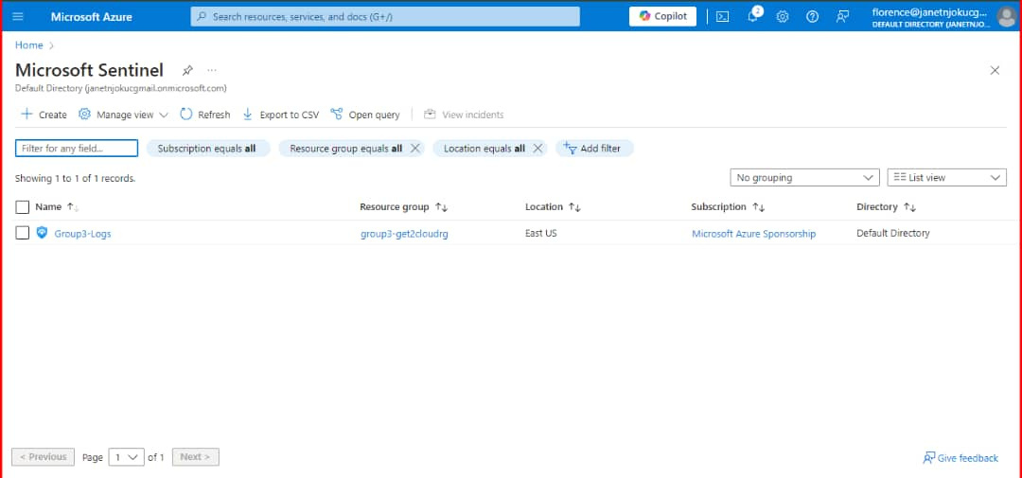
Sentinel Successfully added

Slide 15
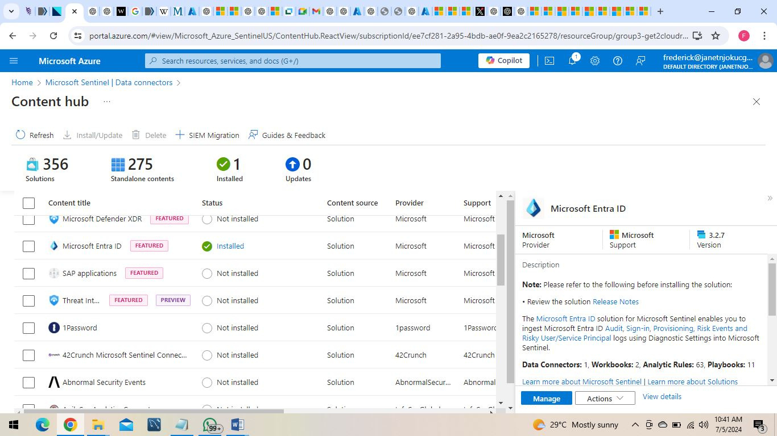
Configuring the Microsoft Entra ID Data Connector

Slide 16
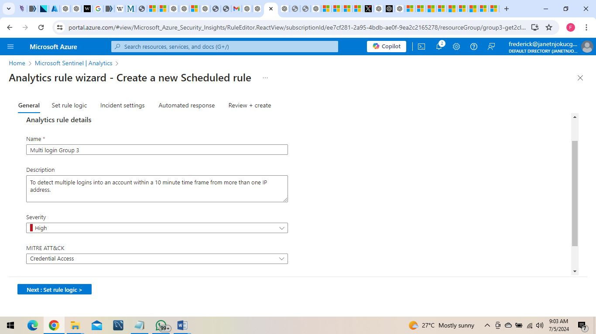
Creating a log analytics rule

Slide 17
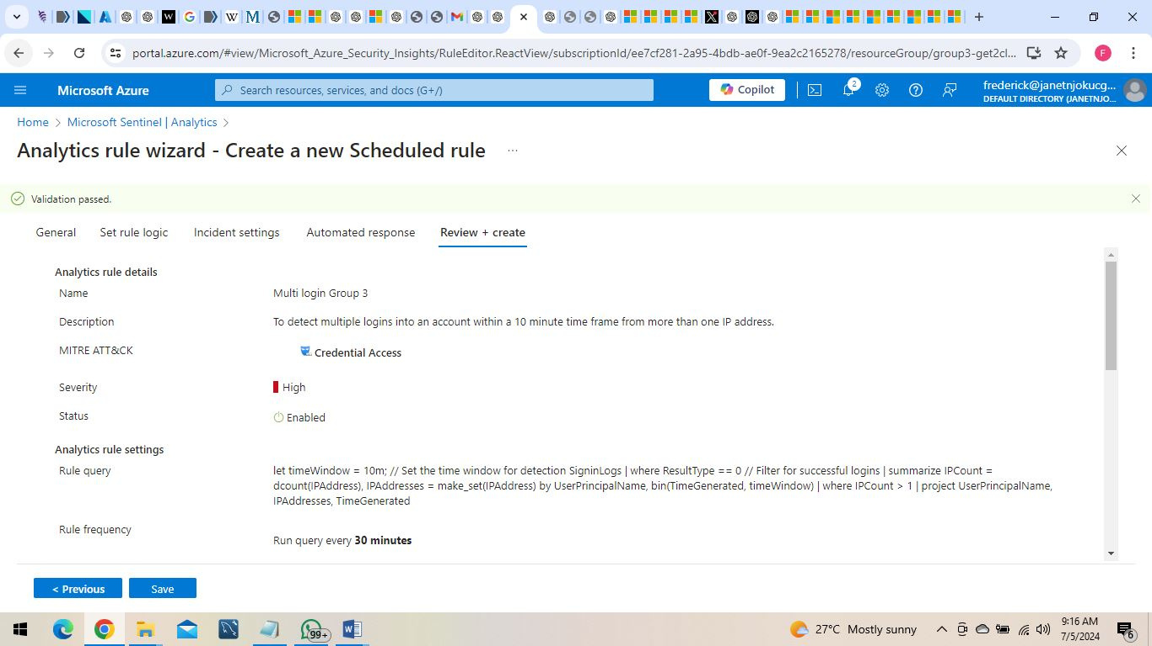
Creation of Log Analytics rule complete

Slide 18
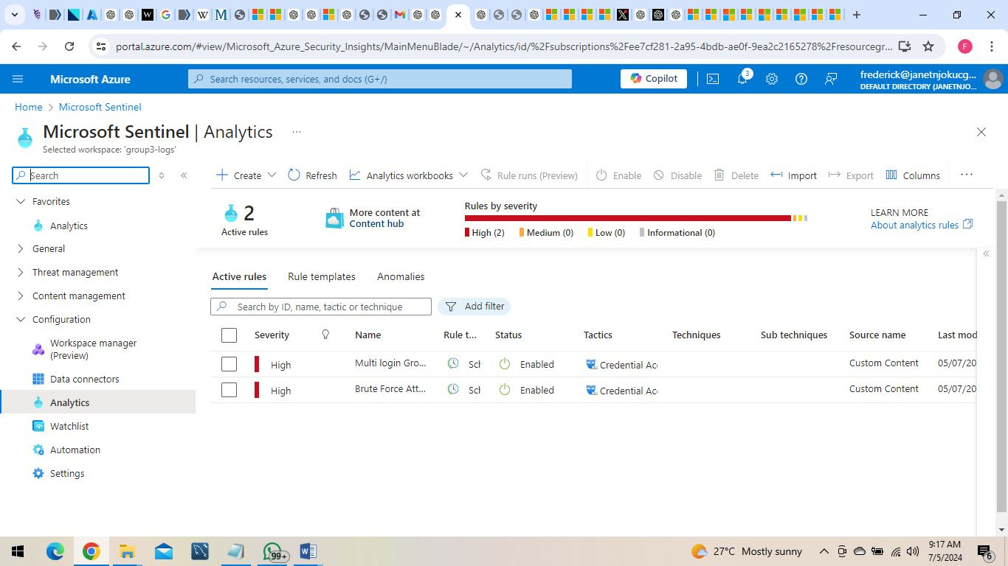
Two Log Analytics rule created successfully

Slide 19
Incident Response with Microsoft Sentinel
1. Playbooks
- Automated response workflows using Azure Logic Apps.
2. Investigation Tools
- Built-in investigation tools to analyze incidents.
3. Case Management
- Incident tracking and management.
4. Collaboration
- Integration with Microsoft Teams and other tools for collaborative response.

Slide 20
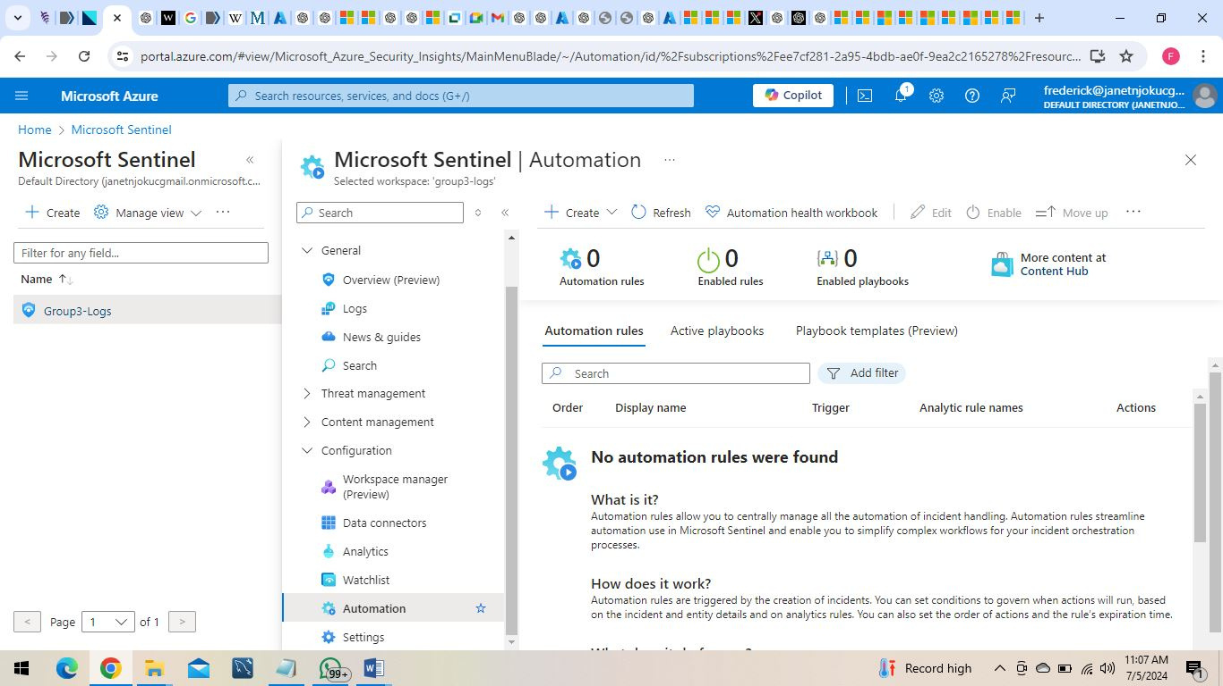
Automation rule yet to be created

Slide 21
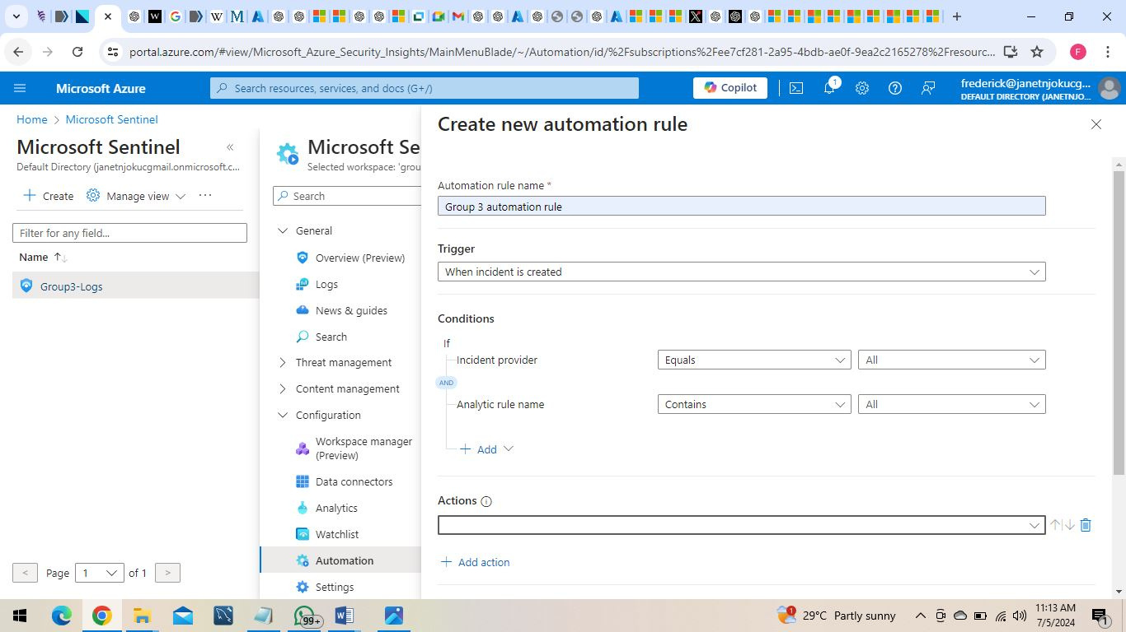

Slide 22
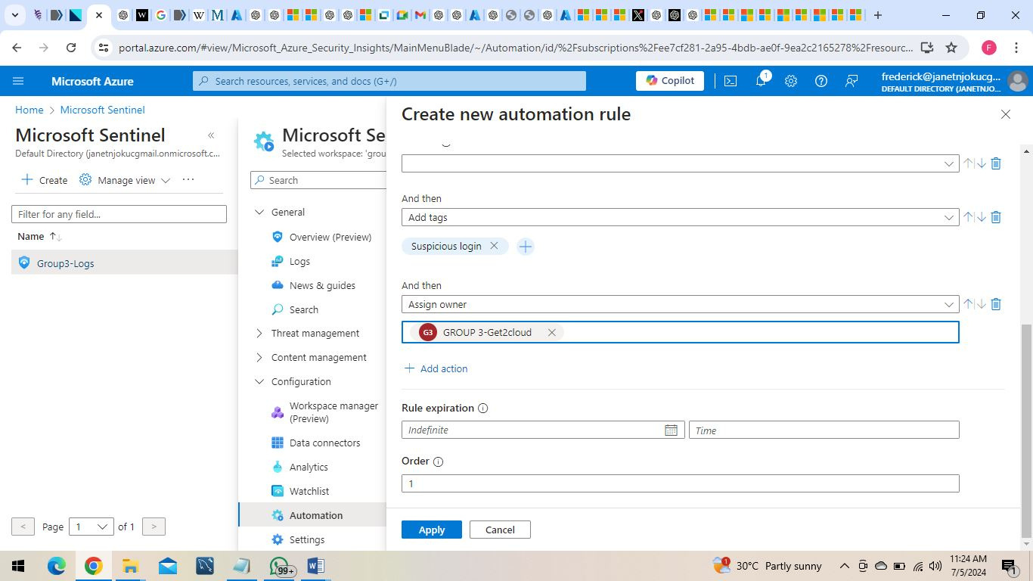
Creation of an Automation rule

Slide 23
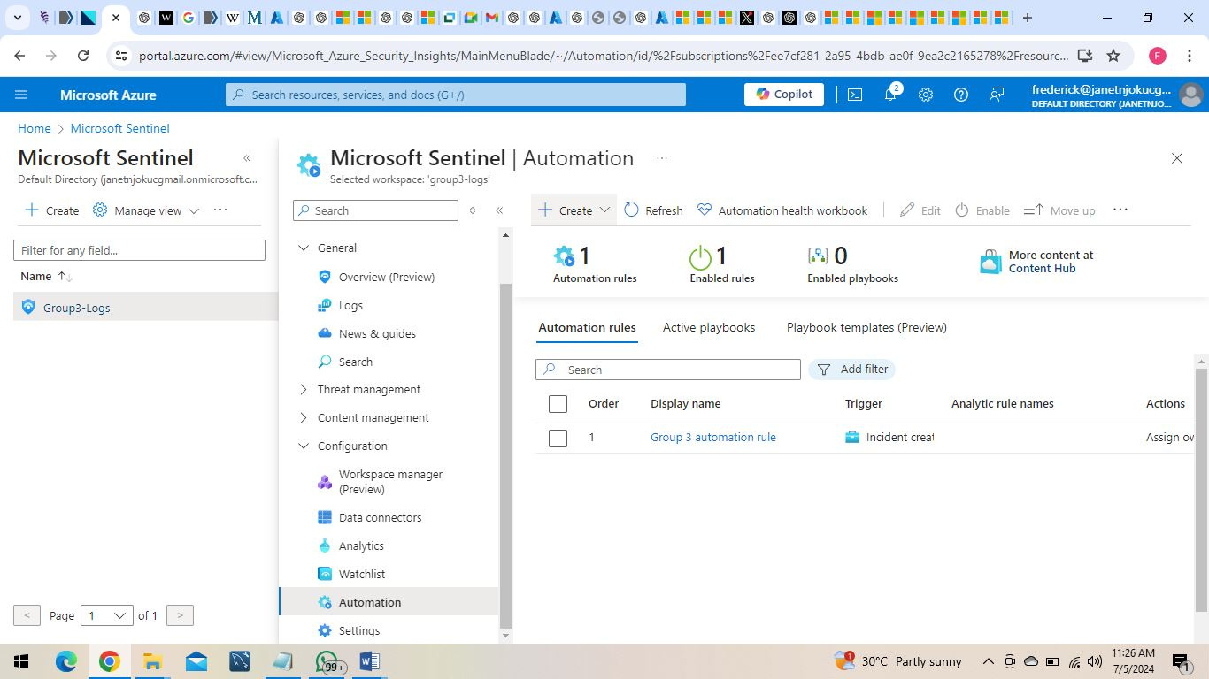
Automation rule enabled

Slide 24
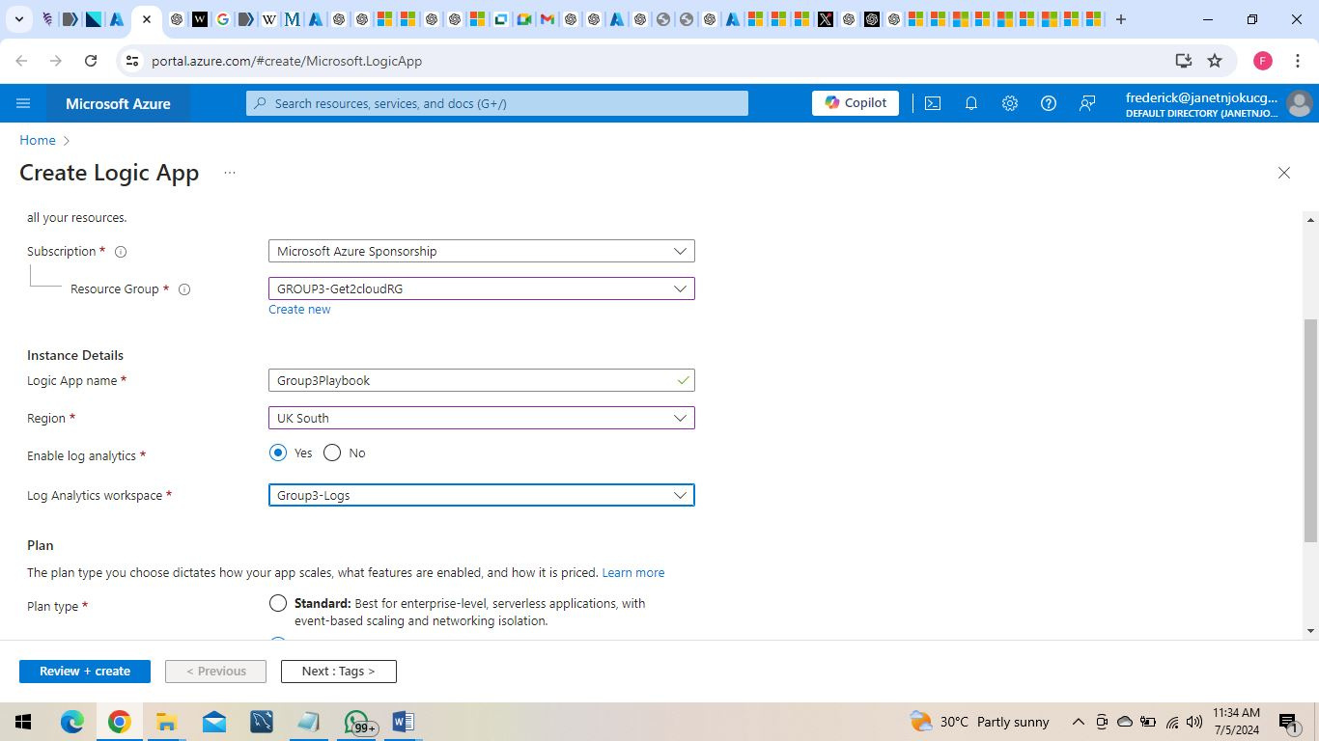
Creation of Logic app to automate Incidence response

Slide 25
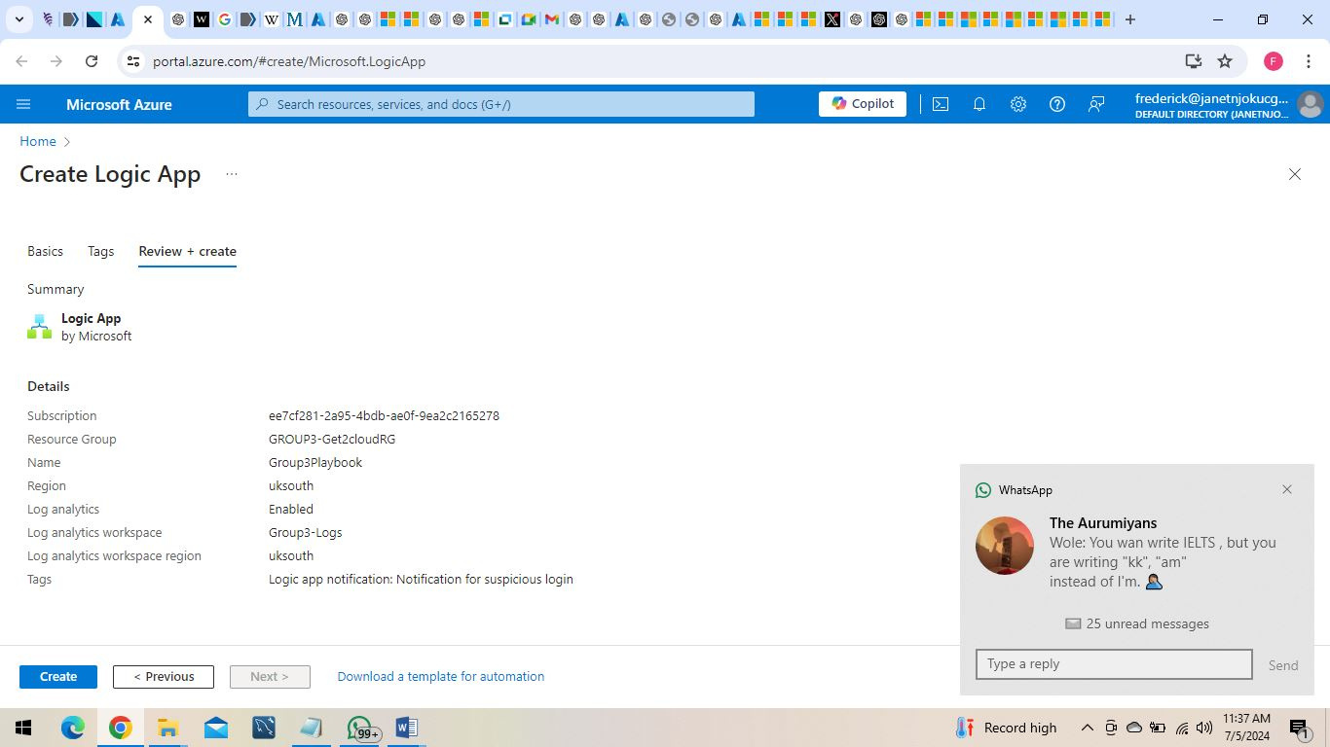

Slide 26
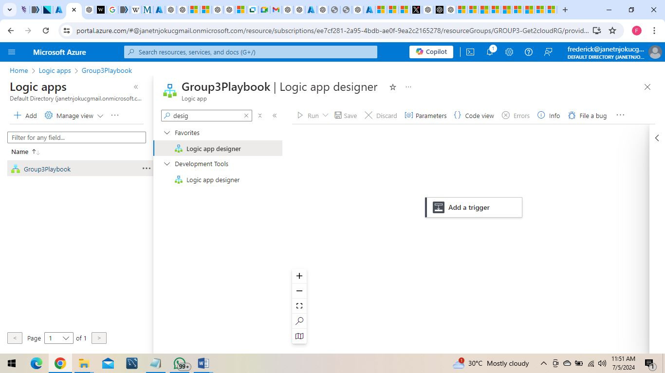
Creating workflows with Logic app designer

Slide 27
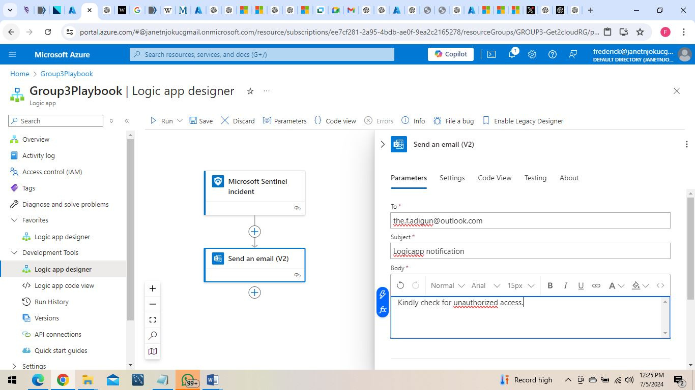
Configuring Logic app Workflows

Slide 28
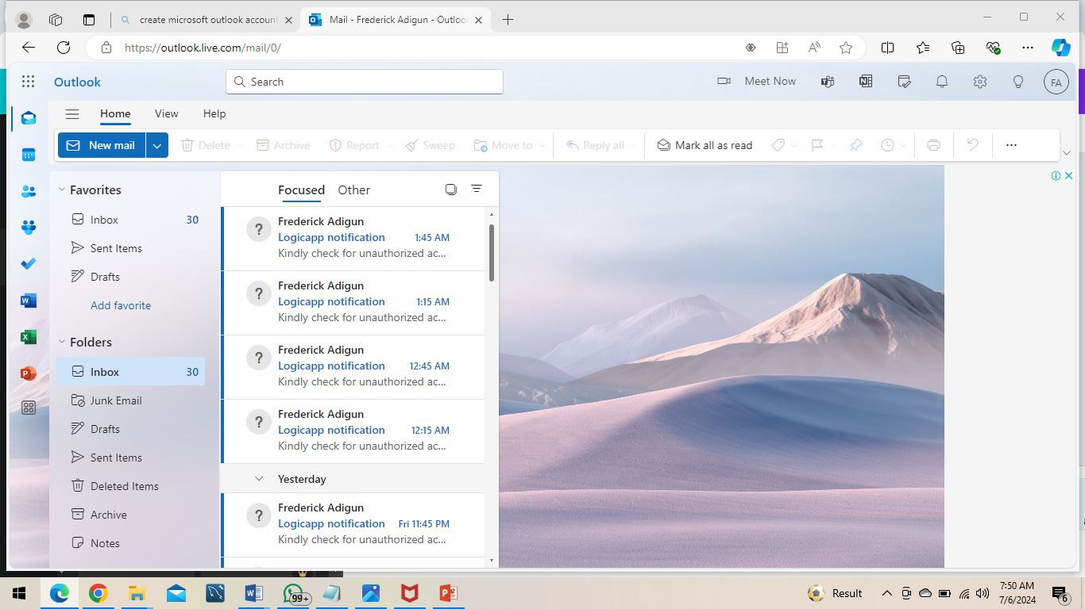
Logic app automatically sending an email when an incident is detected based on configured rules.

Slide 29
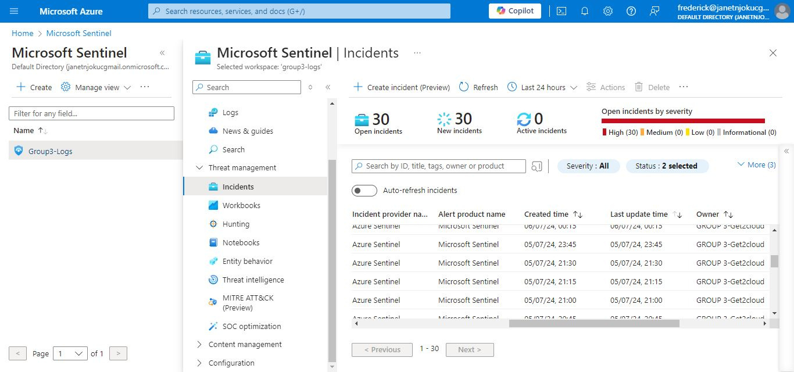
Microsoft Sentinel showing Incidents

Slide 30
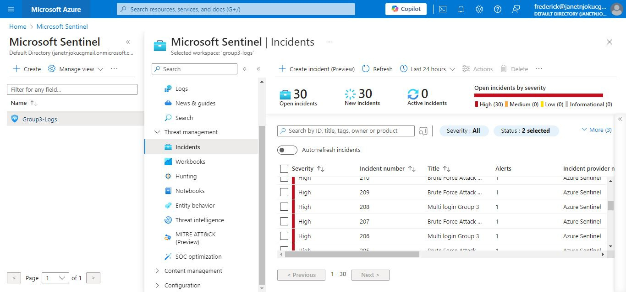

Slide 31
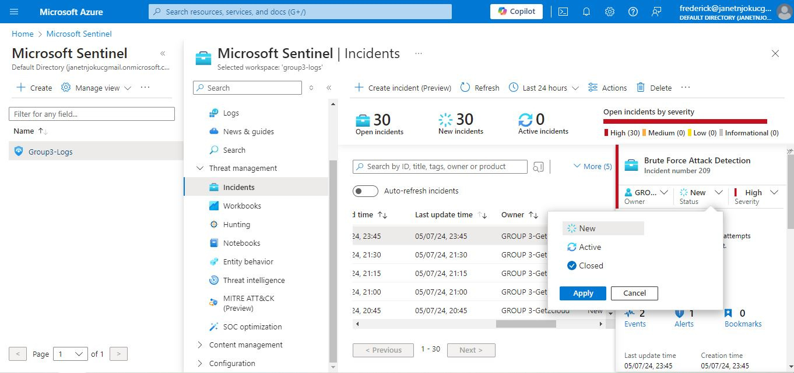

Slide 32
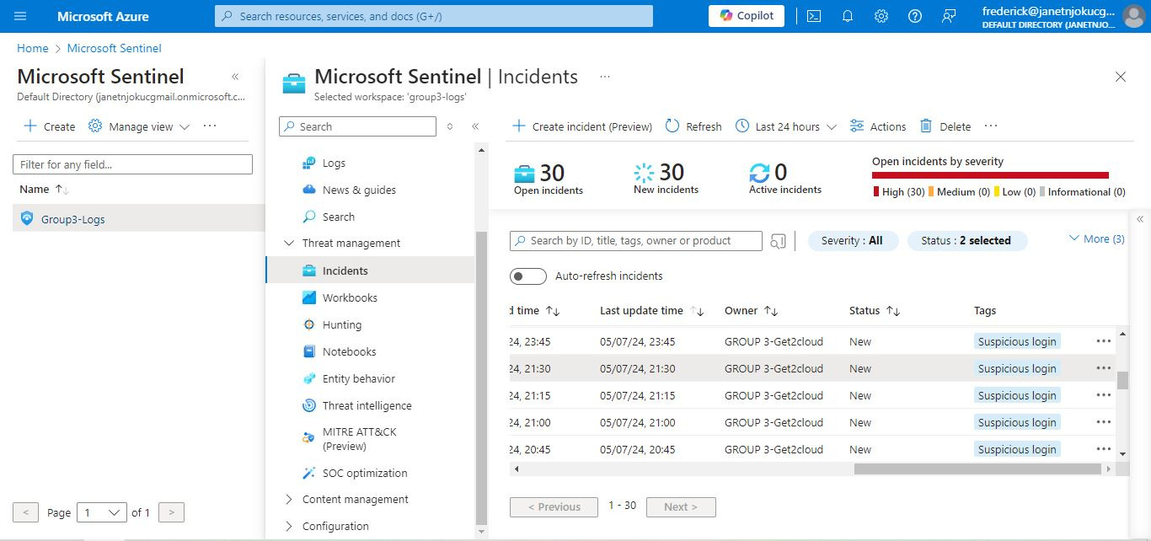

Slide 33
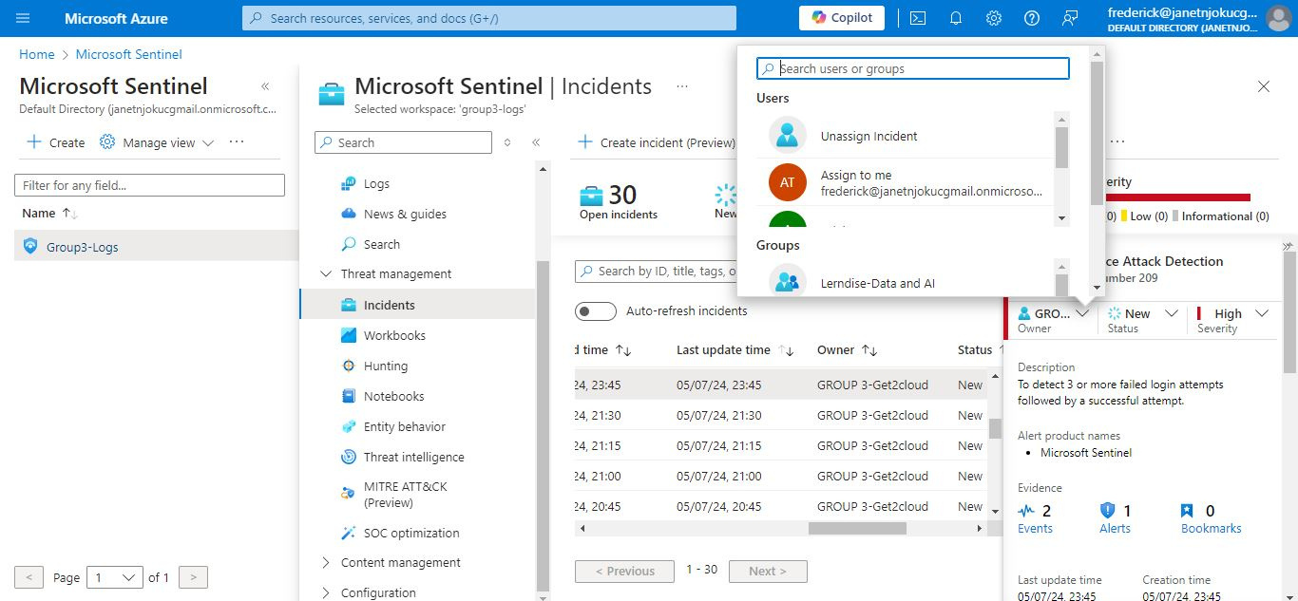

Slide 34
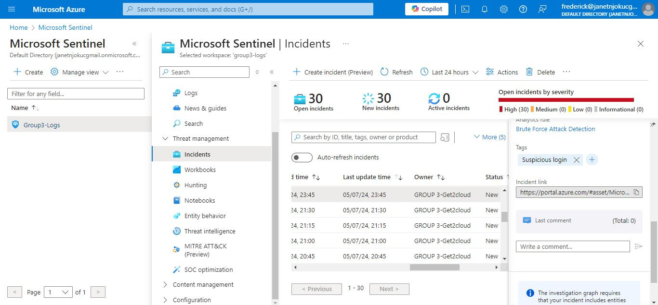

Slide 35
Best Practices
Automate Where Possible: Use playbooks to automate repetitive tasks
Regular Updates: Keep analytic rules and playbooks updated.
Training: Continuous training for security teams.
Integration: Seamless integration with existing security tools and workflows.
Optimization: Regularly review and optimize performance and cost.
Compliance: Ensure compliance with industry standards and regulations.
Leverage Community Resources: Utilize community-provided workbooks, queries, and playbooks.

Slide 36
Challenges
Learning Curve: Microsoft Sentinel and its associated technologies (e.g., Azure Logic Apps, Log Analytics, Azure Monitor) have a steep learning curve.
Configuration Complexity: Setting up and configuring analytics rules, playbooks, and workbooks requires a good understanding of security principles and the specifics of Microsoft Sentinel.
Integration Issues: Integrating various data sources and ensuring seamless data flow into Sentinel was initially complex, as the team was unfamiliar with some of the different systems involved.

Slide 37
Challenges
Skill Gaps: Team members have varying levels of experience and expertise in cybersecurity and Microsoft Azure.
Task Distribution.
Time Management.
Coordination and Communication.
Resource Constraints.
Testing and Validation.
Documentation: Properly documenting the setup, configuration, and use cases for both learning and future reference

Slide 38
Mitigation Strategies
Divide and Conquer: Assign roles based on individual strengths and divide tasks to ensure balanced workload distribution.
Regular Meetings: Hold regular team meetings to discuss progress, address issues, and adjust plans as needed.
Set Clear Goals: Define clear, achievable goals and milestones to keep the project on track.
Leverage Resources: Use available resources such as Microsoft documentation, tutorials, and community forums for guidance and support.

Slide 39
Mitigation Strategies
Practice Scenarios: Creation and extensive practice of different threat scenarios to improve familiarity and response efficiency.
Effective Communication Tools: Use of collaboration tools like Microsoft Teams, Whasapp to keep everyone on the same page.

Slide 40
Conclusion
Microsoft Sentinel: A cloud-native SIEM and SOAR solution for security.
Benefits: AI-driven threat detection, scalability, and cost-effectiveness.
Implementation: Steps include preparation, deployment, data collection, rule configuration, and continuous monitoring.
Monitoring & Response: Real-time threat monitoring and automated incident response.
Stay Proactive: Continuously improve threat monitoring and response.

Slide 41


